Slide 1
Estimating Time and Cost Sensitivity in New Yorker's Transport Decisions: Evidence from the Second Avenue Subway
Applied Data Science - Project Proposal
Guobing Chen, Hao Xi, Fangshu Lin, Nick Jones
10/18/2017

Slide 2
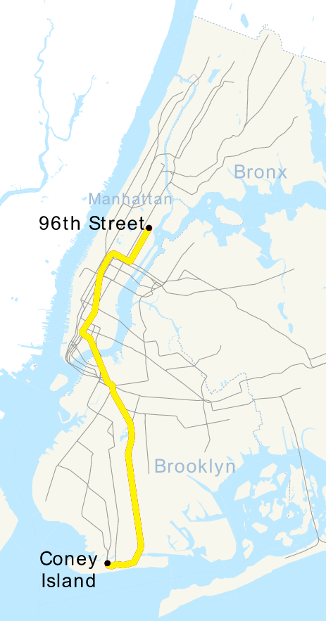
Applied Data Science - Project Proposal
SUMMARY
Background：
In January 2017, three subway stations opened on the Upper East Side as part of the long-awaited Second Avenue Subway.
What we want to do:
use high-resolution transport and weather data
to understand how the subways affected New Yorkers' decisions on what mode of transport to take.
Why choose these new stations:
as a 'natural experiment’
to get new estimates of customer's demand functions for different modes of transportation
In futue: it will be helpful for transport planning such as the siting of new stations.

Slide 3
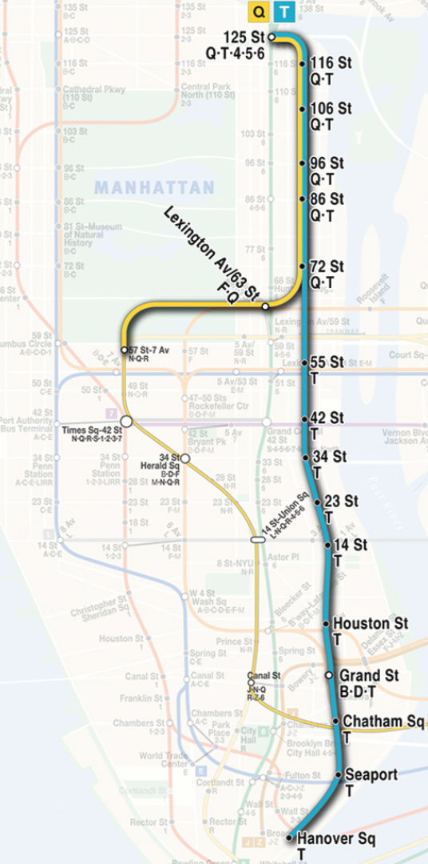
Applied Data Science - Project Proposal
RESEARCH QUESTION
Team Interest:
how the mobility of the neighborhood was affected by the opening of the new subway stations
To Understand this:
Investigate taxi pick-ups and drop-offs in the surrounding area
Investigate how distance from subway station affects the number of pick-ups.
Hypothesis: There are differences in average taxi pick-up numbers between neighborhoods with/without new subway station
We will test for the existence of this distance to subway effect

Slide 4
Applied Data Science - Project Proposal
DATASET
Data type | Accessibility and description
TLC Trip Record Data | Variables of interest include pick-up time, drop-off time, trip distance, longitude, and latitude. Data is high spatial and temporal resolution.
Weather data | Customized historical and real-time weather datasets are available.
Maps | Subway entrances Subway stations Subway lines

Slide 5
Applied Data Science - Project Proposal
METHODS
1. Two parts: Outbound trips & Inbound trips
2. Before & after the Second Avenue Subway was opened
Before: January 1 – July 1 2016
After: January 1 – July 1 2017
3. Variables
Pick-up location
Destination
Trip duration
Pick-up time
Weather condition

Slide 6
Applied Data Science - Project Proposal
METHODS
4. Approaches
i)Hypothesis testing
Test group: neighborhoods have new stations
Control group: the Upper East Side between 60th – 70th St
t-test: Test the differences of mean pick-up/drop-off numbers of different neighborhoods during rush hour.
Chi-square test: test the differences of pick-up/drop-off numbers of different neighborhoods under different weather conditions.
ii)Regression
The distance of pick-up locations to subway stations
Destination
Weather condition
Pick-up time
iii)Cluster analysis
Different neighborhoods’ times series of pick-up/drop-off numbers

Slide 7
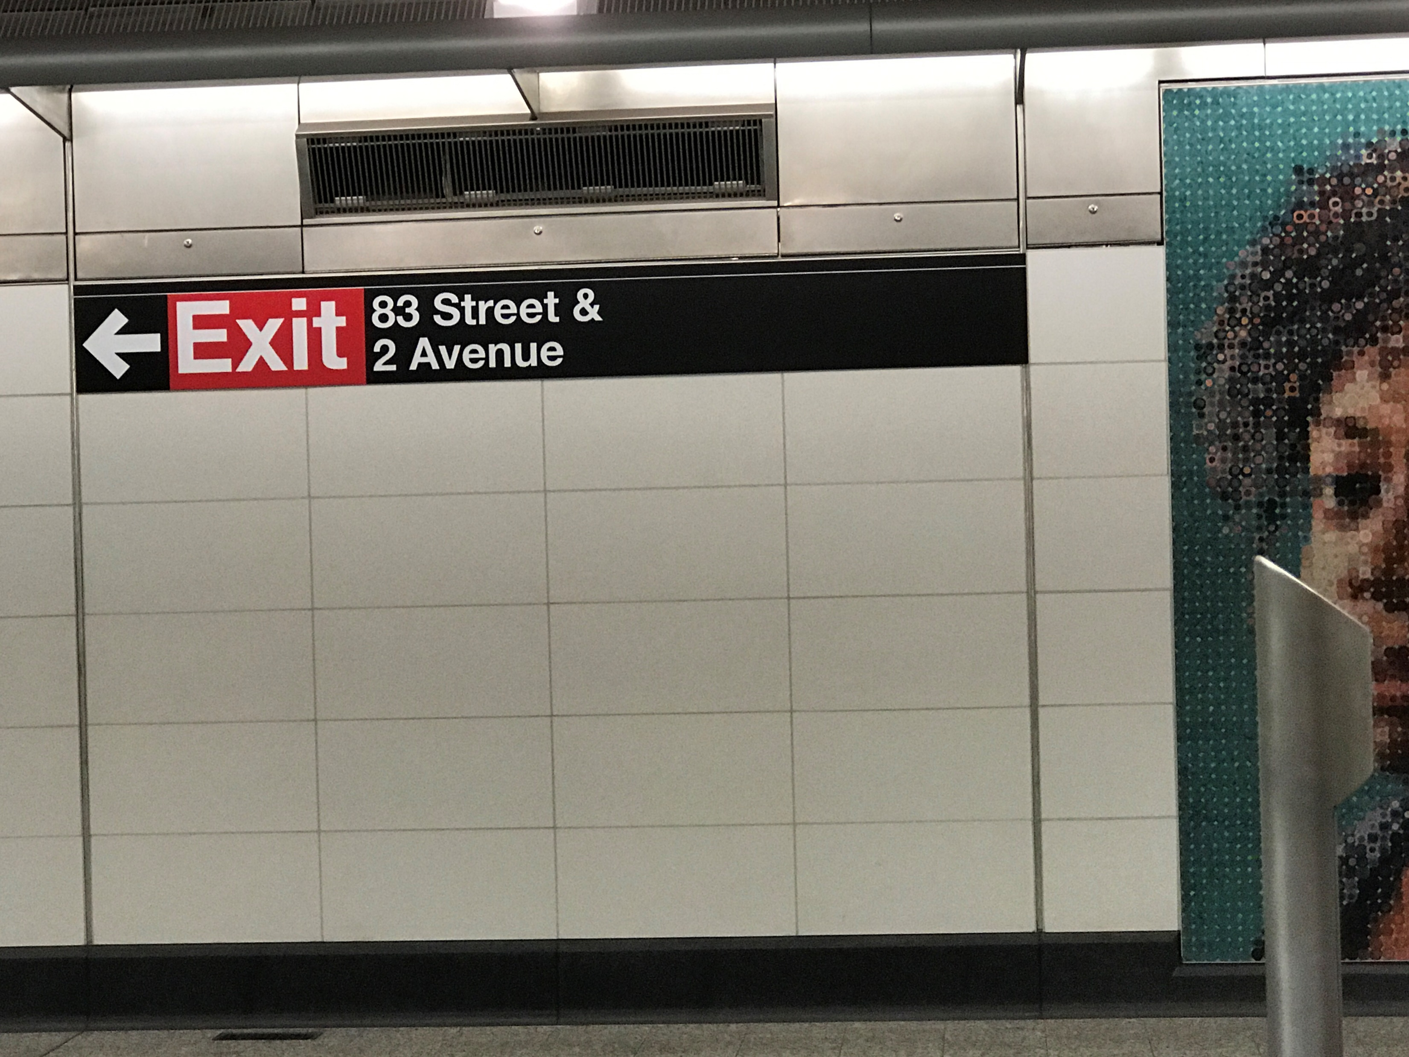
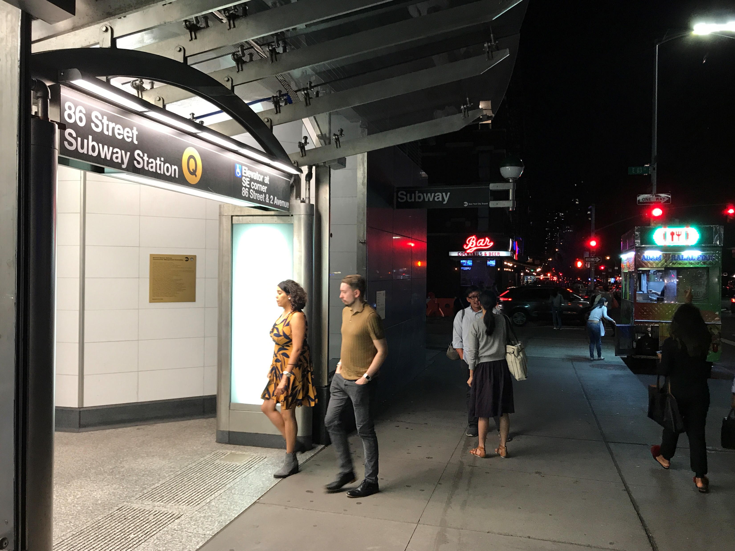
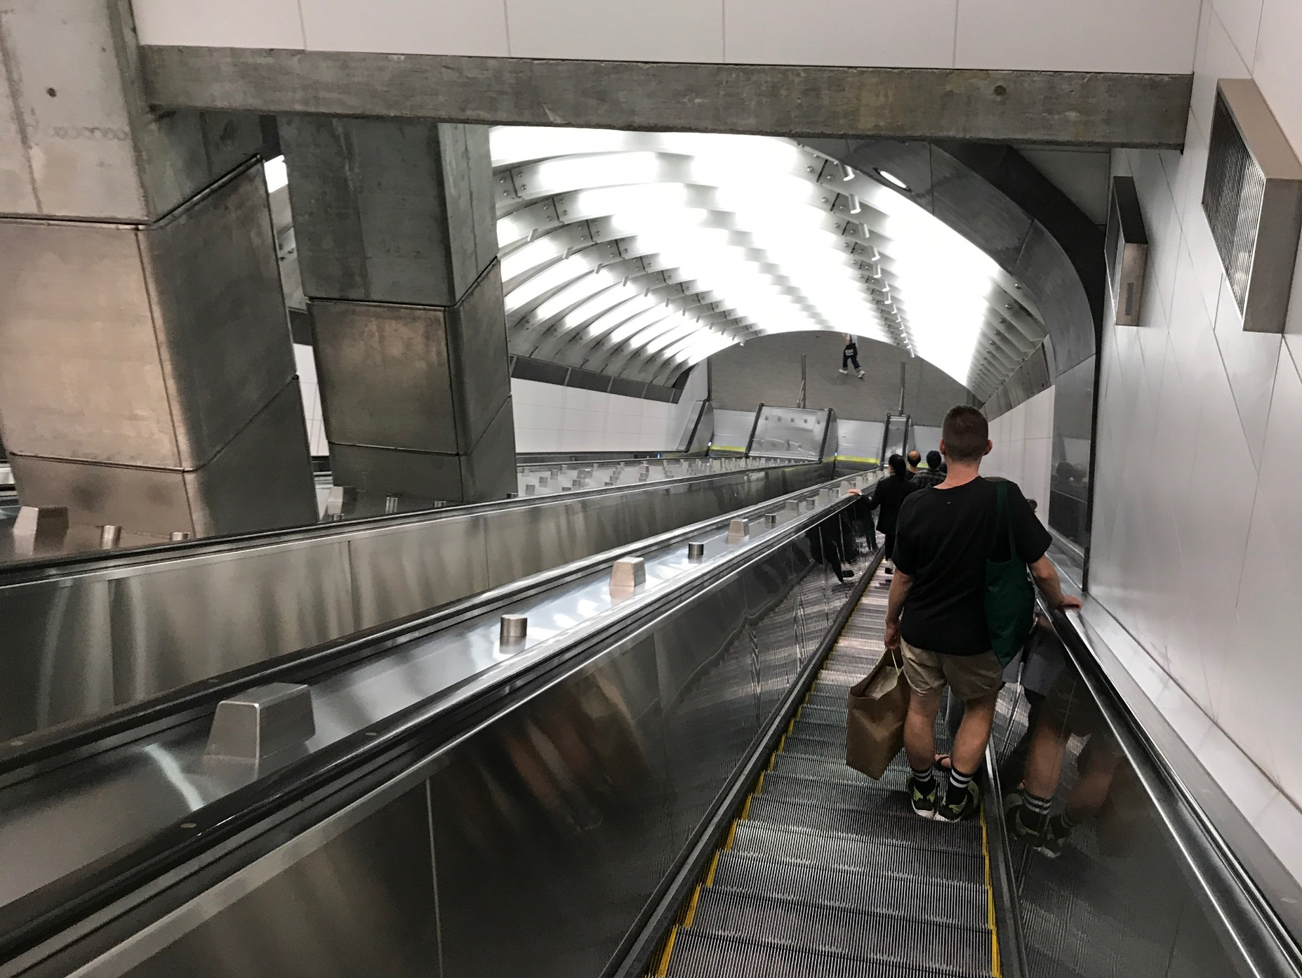
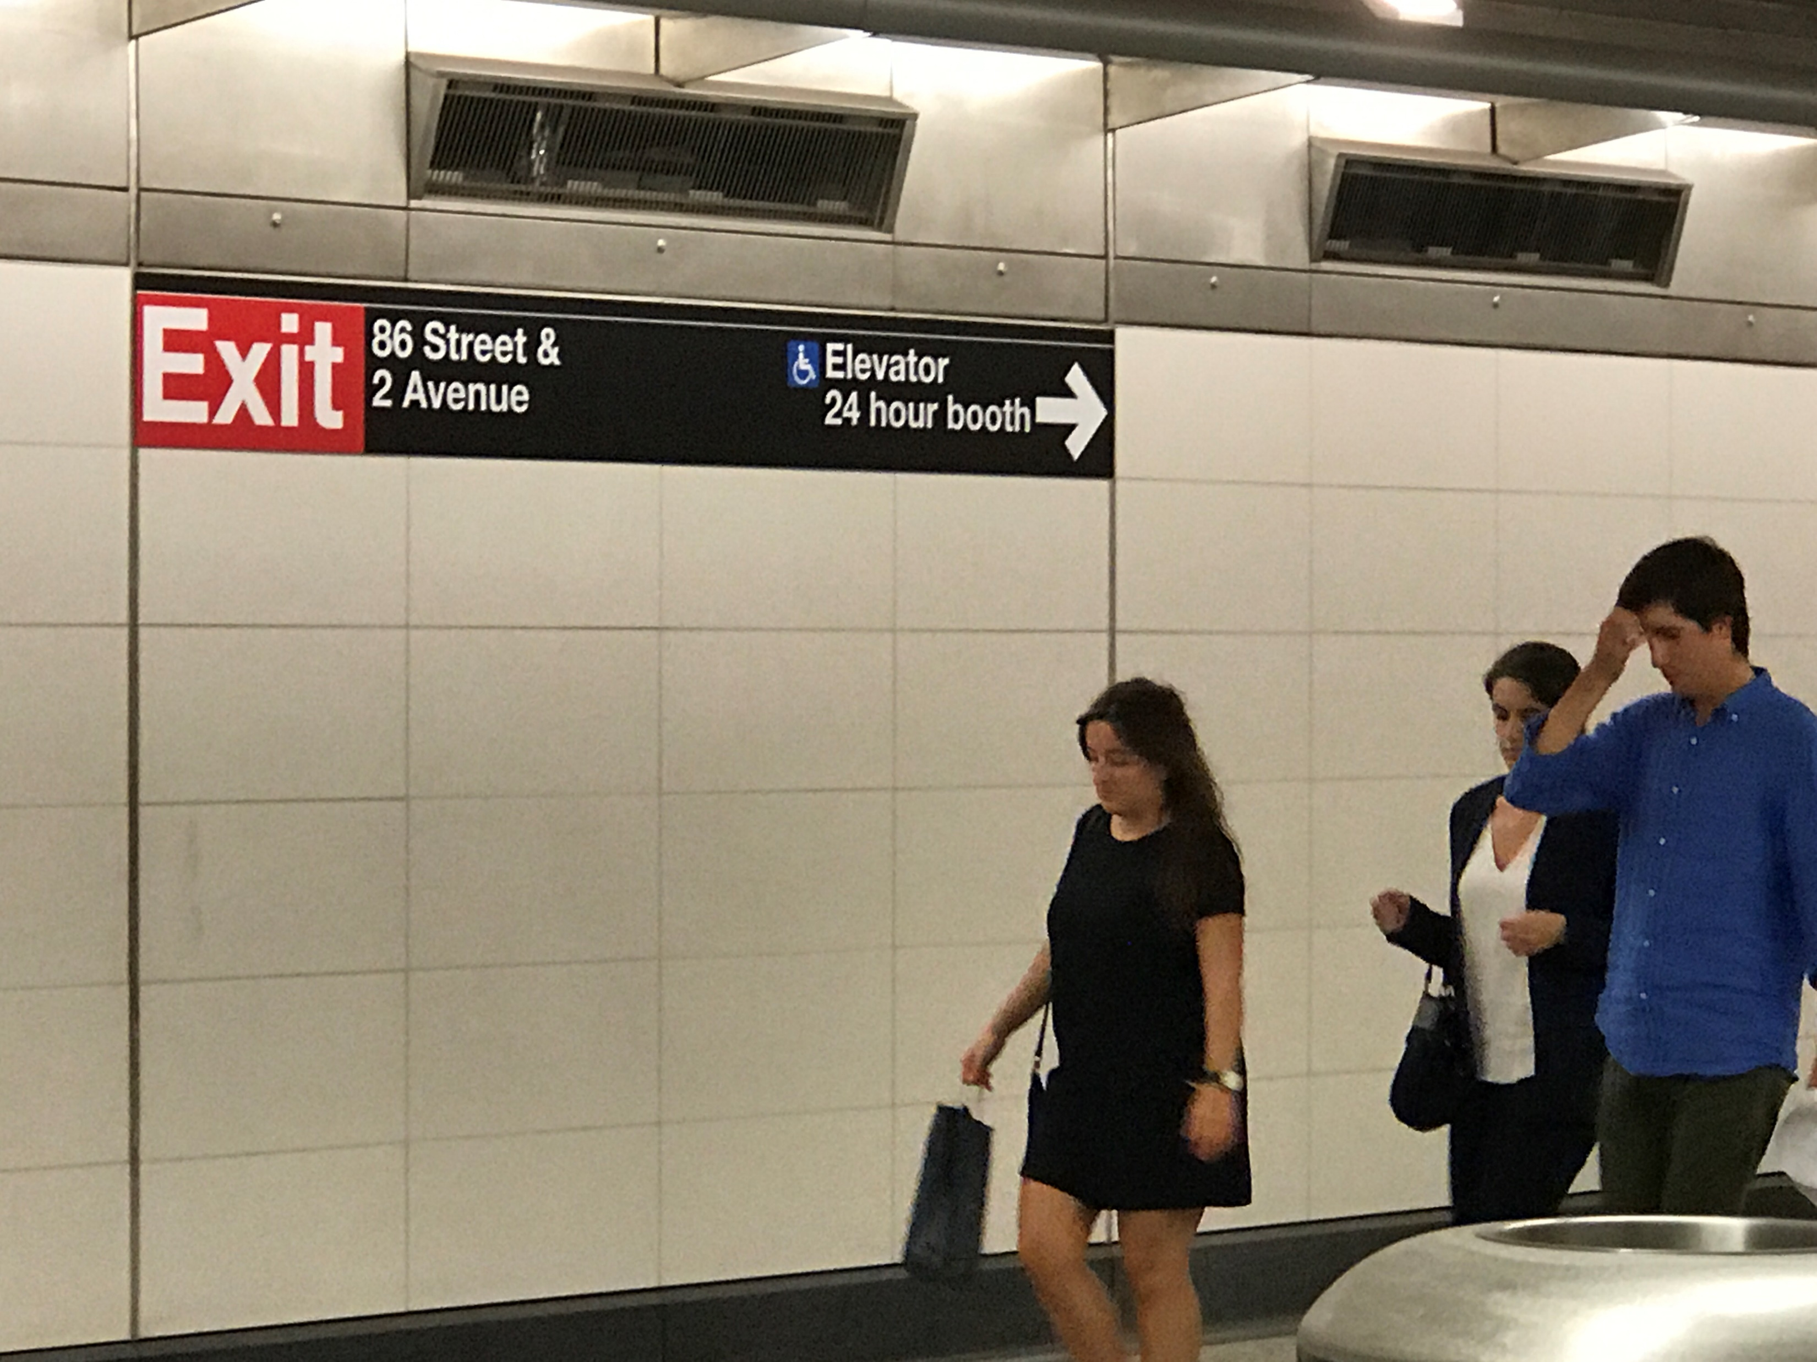
Applied Data Science - Project Proposal
ANTICIPATED ROLES
Hao:
GIS lead, data collection, data wrangling
Fangshu:
Literature review, data collection, data analysis, model building
Guobing:
Data collection, data analysis, model building, visualization
Nick:
Literature review, data collection and analysis, model building
photography work by Nick

Slide 8
Thank You！
Applied Data Science - Project Proposal
Guobing Chen, Fangshu Lin, Hao Xi, Nick Jones
10/18/2017

